Slide 1
HISTORY of Programming Languages
Part 1: History of Programming Languages

Slide 2
Learning Objectives
History of the early programming languages
Influential programming languages

Slide 3
Pre-History

Slide 4
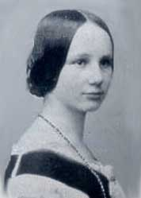
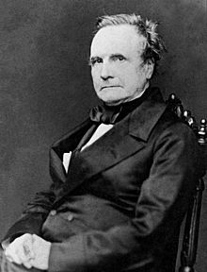
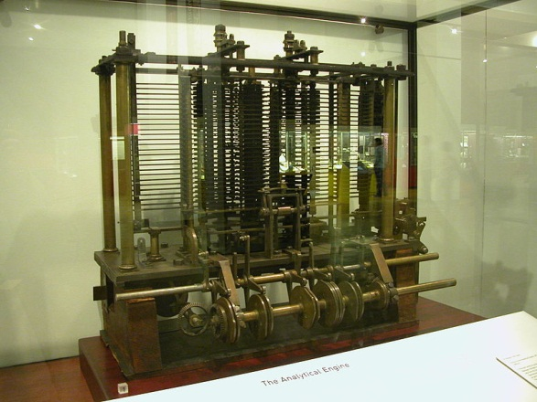
Analytical engine (1837)
Important step in the history of computers.
Mechanical general-purpose computer.
Developed by the British mathematician Charles Babbage.
Ada Lovelace has been credited with the first “program” to be executed by the machine.
Ada Lovelace
Charles Babbage
Analytical engine

Slide 5
Analytical engine (1837)
In its logical design the machine was essentially modern, anticipating the first completed general-purpose computers by about 100 years.
The input (programs and data) was to be provided via punched cards, a method being used at the time to direct mechanical looms such as the Jacquard loom.
For output, the machine would have a printer, a curve plotter and a bell. The machine would also be able to punch numbers onto cards to be read in later.

Slide 6
Analytical engine (1837)
It employed base-10 fixed-point arithmetic. There was to be a store (i.e., a memory) capable of holding 1,000 numbers of 50 decimal digits each, for a total capacity of 20.7KB.
An arithmetical unit (the "mill") would be able to perform all four arithmetic operations, plus comparisons and optionally square roots.
Like the central processing unit (CPU) in a modern computer, the mill would rely upon its own hard-coded internal procedures, to be stored in the form of pegs inserted into rotating drums called "barrels," in order to carry out some of the more complex instructions the user's program might specify.

Slide 7
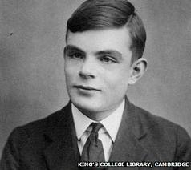
Analytical engine (1837)
The programming language to be employed by users was akin to modern day assembly languages.
Loops and conditional branching were possible and so the language as conceived would have been Turing-complete, one hundred years before Alan Turing's concept of Turing Machine and Turing Completeness.
Alan Turing

Slide 8
Birth of Programming languages

Slide 9
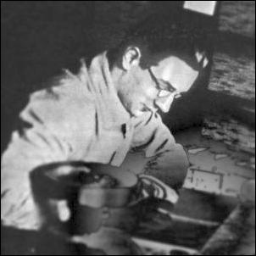
Plankalkül (1941)
Plankalkül is a computer language developed for engineering purposes by Konrad Zuse, a German Civil Engineer and inventor.
It was invented as the programming language for the Z3, the first programmable electromechanical computing machine, which Zuse built on his own in 1941.
Konrad Zuse
It was the first high-level non-von Neumann programming language to be designed for a computer and was designed between 1943 and 1945.
It was not known for a long time owing to a combination of factors such as conditions in wartime and postwar Nazi Germany.

Slide 10
Plankalkül (1941)
By 1946, Zuse had written a book on the subject but it remained unpublished.
In 1948 Zuse published a paper about Plankalkül in the "Archiv der Mathematik" but still did not attract much feedback - for a long time to come programming a computer would only be thought of as programming with machine code.
Plankalkül was eventually more comprehensively published in 1972 and the first compiler for it was implemented in 1998.
Another independent implementation followed in the year 2000 by the Free University of Berlin.

Slide 11
Plankalkül (1941)
Plankalkül drew comparisons to APL and relational algebra.
It includes assignment statements, subroutines, conditional statements, iteration, floating point arithmetic, arrays, hierarchical record structures, assertions, exception handling, and other advanced features.
Thus, this language included many of the syntactical elements of structured programming languages that would be invented later, but it failed to be recognized widely.

Slide 12
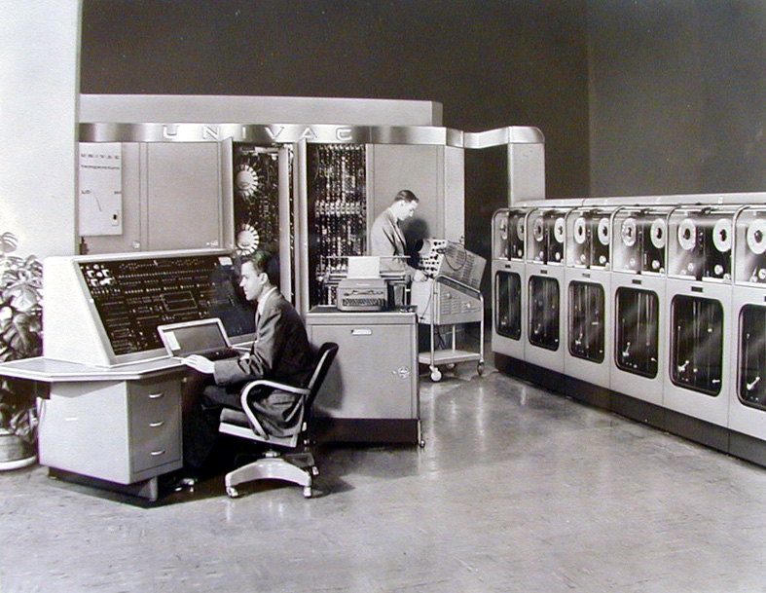
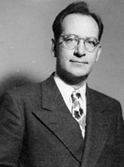
Short Code (1949)
Short Code was the first higher-level language ever developed and used for a computer.
Short Code was designed in 1949 by John Mauchly, co-inventor of UNIVAC I, the first commercial computer produced in the United States.
John Mauchly
UNIVAC

Slide 13
Short Code (1949)
Unlike machine code, Short Code statements represented mathematical expressions rather than a machine instruction.
While Short Code represented expressions, the representation itself was not direct and required a conversion process then called automatic programming.
Along with basic arithmetic, Short Code allowed for branching and calls to a library of functions.
The language was interpreted and ran about 50 times slower than machine code.

Slide 14
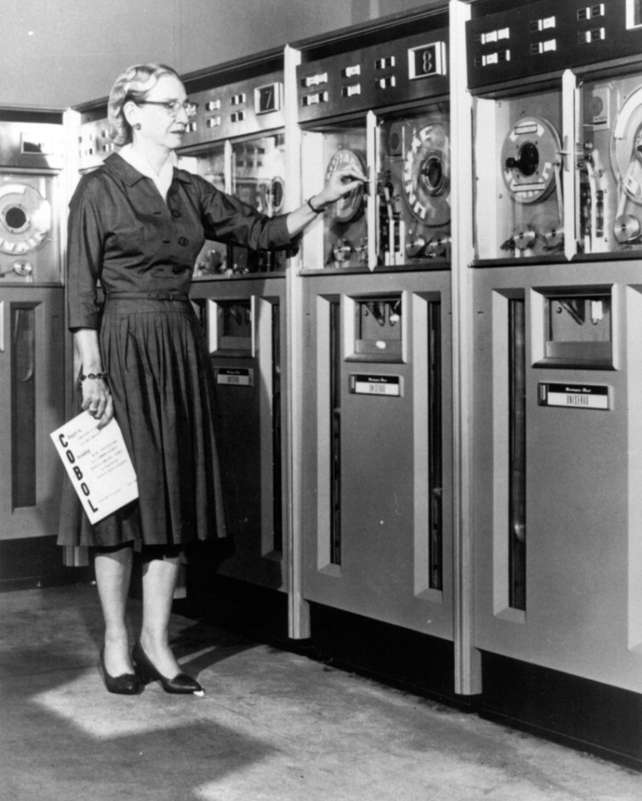
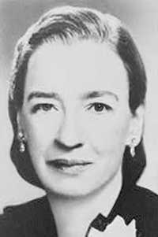
A-0 (1951)
The A-0 system, written by Grace Hopper in 1951 and 1952 for the UNIVAC I, was the first compiler system ever developed for a computer.
Grace Hopper
Grace Hopper and UNIVAC

Slide 15
A-0 (1951)
A-0 functioned more as a loader/linker than the modern notion of a compiler.
A program was specified as a sequence of subroutines and arguments. The subroutines were identified by a numeric code and the arguments to the subroutines were written directly after each subroutine code.
The A-0 system converted the specification into machine code that could be fed into the computer in a second pass to execute the program.

Slide 16
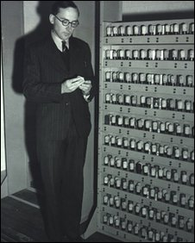
A-0 (1951)
A similar systems was invented independently by David Wheeler and Maurice Wilkes for the EDSAC computer in 1951.
Maurice Wilkes and EDSAC

Slide 17
Evolution of Programming languages

Slide 18
Fortran

Slide 19
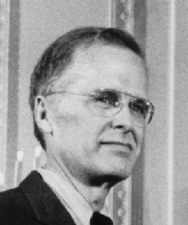
Fortran
IBM Mathematical Formula Translating System, later popularly know as Fortran.
Originally developed by a team lead by John Backus at IBM in the 1950s for scientific and engineering applications on the IBM704, introduced in 1954.
General-purpose, procedural, imperative programming language that is especially suited to numeric computation and scientific computing.
John Backus
Originally designed to improve on the economics of programming, as programming using low level languages had become to be more costly than the time it actually saved.

Slide 20
Fortran
The solution was to design a higher level programming language enabling scientists to write programs using a mathematical notation/language.
Great emphasis was put on the efficiency of the translated machine code, which is still the case today, explaining why Fortran programs are still considered as a benchmark for execution speed.
Emphasis was put on number computations. Only much later was it possible to have Fortran programs manipulate characters or strings.

Slide 21
Fortran
Features introduced by earlier versions of Fortran:
Comments
Assignment statement using complex expressions
Control structures (conditional, loop)
Subroutines and functions used similarly to the mathematical notion of function
Formatting of input/output
Machine independent code
Procedural programming
Arrays
Early development of compilers
Showed the importance/possibility/relevance of higher-level programming languages
Compiler development tools/techniques
Optimizing compiler

Slide 22
Fortran
Reasons explaining Fortran’s early success:
Made efficient use of programmer’s time
Easy to learn and use by scientists
Was fully supported by IBM for many years
At the time, most applications and users were scientific
Simplified many tedious tasks such as input/output formatting
Compiler was generating very well optimized code
Fortran is still one of the most popular languages in the area of high-performance computing and is the language used for programs that benchmark and rank the world's fastest supercomputers.

Slide 23
Fortran
Fortran 0 (1954):
assignment, if, goto, do loop, formatted/unformatted I/O, pause, stop, continue, notion of basic block (entry/exit point)
Fortran I (1955-1957)
First implemented compiler
Fortran II (1958):
procedural programming, pass by reference, return statement, independent compilation of subroutines
Fortran IV (1961-62):
machine-independence, boolean expressions, logical operations, explicit type declarations, subroutines as parameters.
Fortran 66 (1966):
first standard, based on Fortran IV

Slide 24
Fortran
Fortran 77 (1977-78):
Fixed problems in Fortran 66, string handling. Historically most important dialect.
Fortran 90 (1991-92):
Includes many features of modern programming languages: recursion, modules, generic procedures, operator overloading, abstract data types, dynamic memory allocation, dynamic data structures, case statement. Also removed many obsolescent features/constructs.
Fortran 95 (1995):
minor revisions, but most notably included many features of High Performance Fortran, a data-parallel version of Fortran.
Fortran 2003 (2003):
Major revision. object-orientation, constructors, finalizers, asynchronous I/O, procedures pointers, interoperability with C, enhanced modularity features.
Fortran 2008 (2010):
Minor upgrade vs Fortran 2003, added more constructs for parallel execution.

Slide 25
cobol

Slide 26
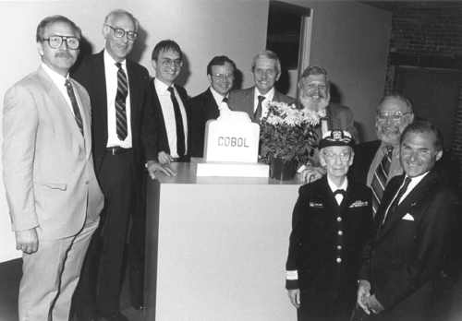
Cobol
Acronym for COmmon Business-Oriented Language
Primary domain in business, finance, and administrative systems.
A specification of COBOL was initially created during the second half of 1959 by Grace Hopper.
The specifications were to a great extent inspired by the Grace Hopper’s FLOW-MATIC and IBM’s COMTRAN languages.
Left to right: Ron Hamm, John L. Jones, Dr. Jan Prokop, Oliver Smoot,
Tom Rice, Donald Nelson, Commodore Grace M. Hopper,
Michael O'Connell and Howard Bromberg. © Computer History Museum

Slide 27
Cobol
Initial meeting for the creation of COBOL (then named CBL) was held at the Pentagon in May 1959.
The meeting agreed to the following requirements:
Use of English (as business is in English)
Ease of use (even at expense of performance)
Both these requirements aimed at its use by business people
Emphasis was put on immediate action, as many other such languages/systems were attempted at the time.
By December 1959, a first version was defined, which was refined in 1961 and 1962.
A standard version was defined in 1968. Further standardized evolutions were defined in 1974, 1985 and 2002.

Slide 28
Cobol
First programming language advocated by the United States Department of Defense, which contributed to its success.
The development of Cobol paralleled that of Fortran.
It is a data processing language, making it different from Fortran and Algol.
Puts explicit emphasis on the description of the manipulated data at two levels:
Machine-dependent description (environment division) providing a connection between the Cobol program and the data files as stored on a specific media.
Machine-independent logical description of data as manipulated by procedures.

Slide 29
Cobol
Positive:
Macros
Hierarchical data structures
Descriptive variable names
Elaborated Input/Output formatting
Built-in searching/sorting procedures
Backed-up by Department of Defense
Negative:
Poor performance of early compilers
Restricted to business data applications

Slide 30
Cobol
Was never intended as an innovative language. It had very limited influence on subsequent languages.
Cobol was much more standardized compared to Fortran and Algol
Goal: orderly wide use of the same language in business data processing.
Adverse effect: language was limited in its evolution, and stayed mostly the same throughout the most part of its lifetime.
Newest standard (1990s) includes object-orientation and garbage collection.
Despite being more than 50 years old, tens of billions of lines of Cobol code are still in use behind the scenes in the applications of many businesses and government systems worldwide.

Slide 31
lisp

Slide 32
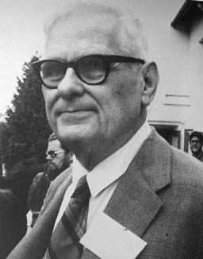
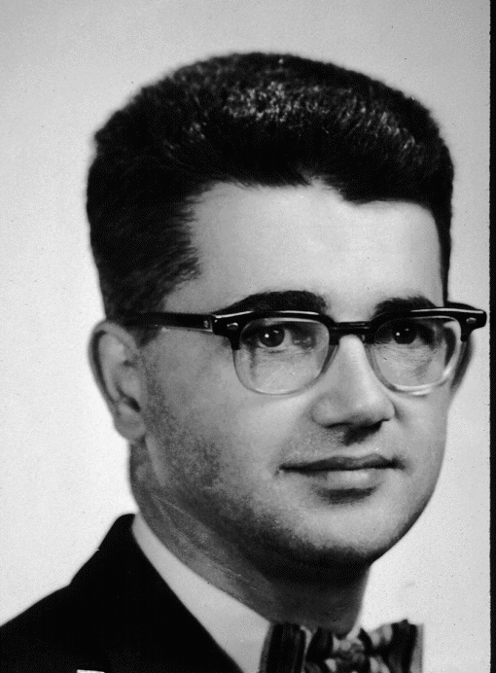
Lisp
Lisp was created by John McCarthy in 1958 as a practical mathematical notation for computer programs, influenced by the notation of Alonzo Church's lambda calculus.
Lisp pioneered many ideas in computer science, including:
functional programming
tree data structures
automatic storage management
dynamic typing
self-hosting compiler
Alonzo Church
John McCarthy
The name LISP derives from "LISt Processing“, as linked lists are one of Lisp language's major data structures, and Lisp source code is itself made up of lists.

Slide 33
Lisp
LISP was designed by McCarthy as a language to express symbolic computations, i.e. programs that aim at manipulating mathematical expressions, for example:
simplification of expressions
differentiation and integration
polynomial factorization
Some of the requirements for such a language was the availability of:
recursion: lambda calculus uses recursion pervasively
linked lists: to implement lambda calculus, which implied dynamic memory allocation and deallocation.

Slide 34
Lisp
Lisp implementation relies on a self-hosting compiler (eval function). As a result, a Lisp program can manipulate its own source code as a data structure, giving rise to the macro systems that allow programmers to create new syntax or even new domain-specific languages embedded in Lisp.
This feature is a part of what is now called “reflective programming”.
Lisp has been used extensively for artificial intelligence. It has been the subject of many revisions and expansions, the latest and most common ones being Scheme and Common Lisp.
Common Lisp includes the Common Lisp Object System (CLOS), a very original implementation of object-oriented programming.

Slide 35
Lisp
Lisp pioneered the notion of functional programming language.
All computations are done by applying functions to arguments.
Does not have variables or assignment operator.
Repetitive processes are achieved by recursion.
Other functional programming languages include:
ML: Robin Milner, University of Edinburgh, 1980s, including many other variants.
Miranda: David Turner, University of Kent, 1980s.
Haskell: Evolution of Miranda, 1990s.
F#: .NET language that provides functional and object-oriented imperative language features

